Slide 1
Connected Work Zone Software Toolchain
Work Flow and Current Progress
Niraj Vasant Altekar
04/25/2019

Slide 2
Outline
Process Flow
Pre-requisites
Configuration
CAMP Software Tool Chain - Flow
Data collection
Work Zone configuration
Map Builder
Map Visualizer
Other Observations and Notes

Slide 3
Process Flow
Initial Configuration ✓
CAMP Software Toolchain
Vehicle Path Data Acquisition ➔ (.csv) ✓
(.csv) ➔ Work Zone Configuration ➔ (.wzc) ✓
(.wzc) ➔ Map Builder ➔ (.xml) ✓
Map Visualizer ✓
(.xml) ➔ RSM Message Builder ➔ (.uper) ✓
(.uper) ➔ Deployment on the RSU through RSU4.1 Interface
Processing on OBU

Slide 4
Pre-requisites
Hardware:
External computer for data collection and message development.
U-Blox EVK-M8N GNSS Evaluation Kit for receiving GPS data.
Software (External Computer) :
Python
U-Center v8.25
CAMP Connected work zone software toolchain

Slide 5
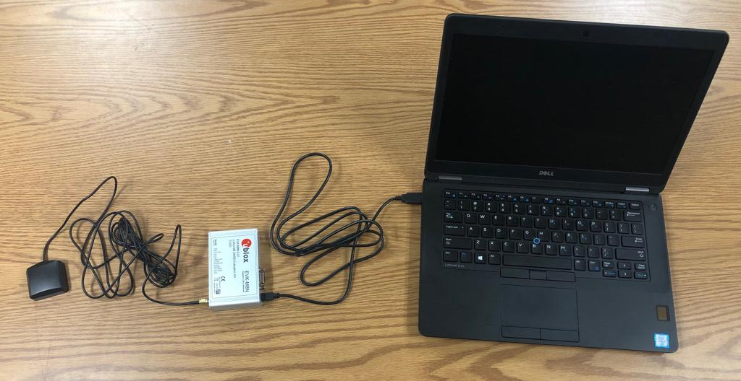
Physical Connections
External Computer
GPS Receiver
U-Blox GNSS Evaluation Kit

Slide 6
Configuring U-Blox GPS Receiver
Install U-blox supplied u-center software (v8.25)
Connect GPS receiver with supplied USB cable to a USB port on PC. (Virtual serial port connectivity)
Launch the u-center application.
To setup baud rate for serial communication: a. Select Receiver ➔ Port – Note down the virtual serial port number. This port number will be used by the Vehicle Path Data Acquisition tool.
Select Receiver ➔ Baud rate ➔ 115200
To apply configuration file: ALL_CAMP_V2V_MD_UbloxM8N-10Hz_GPS_Only_Config_v1.2.txt located in U-blox EVK M8N folder in the toolchain distribution package
Select Tool ➔ GNSS Configuration
Select and apply the configuration file

Slide 7
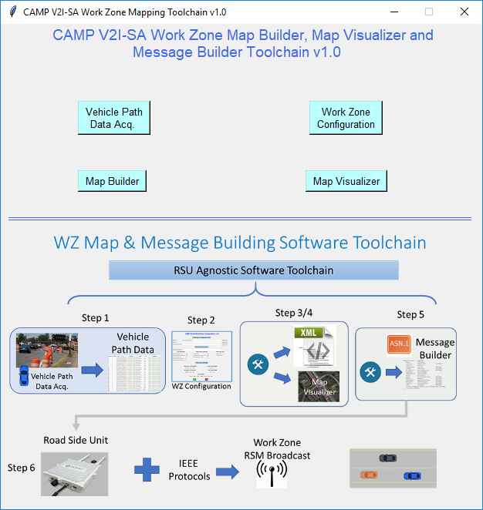
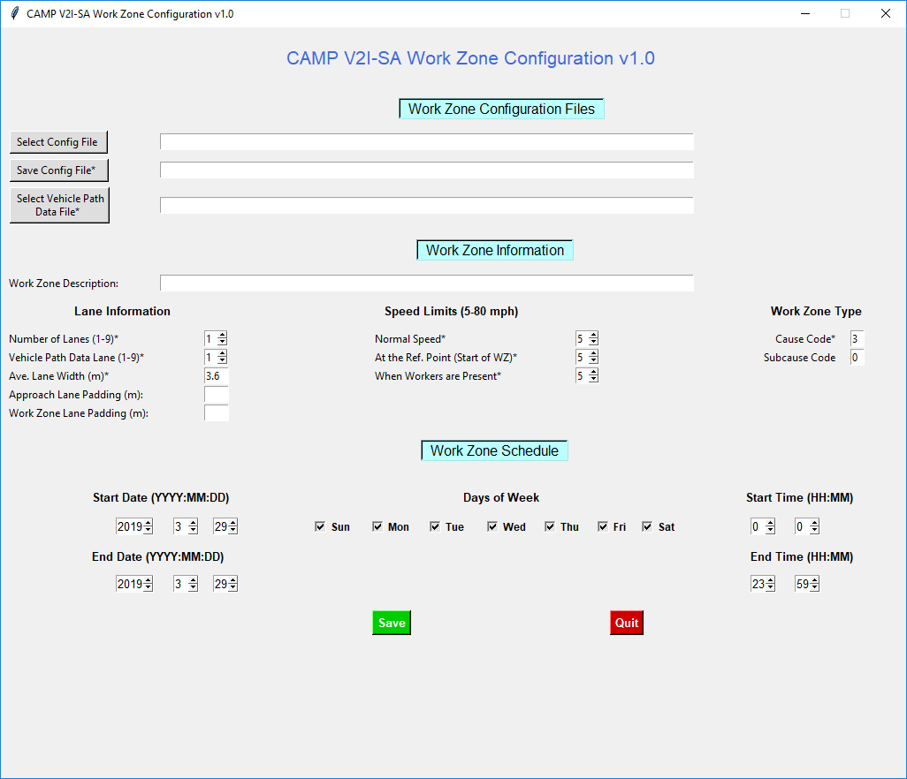
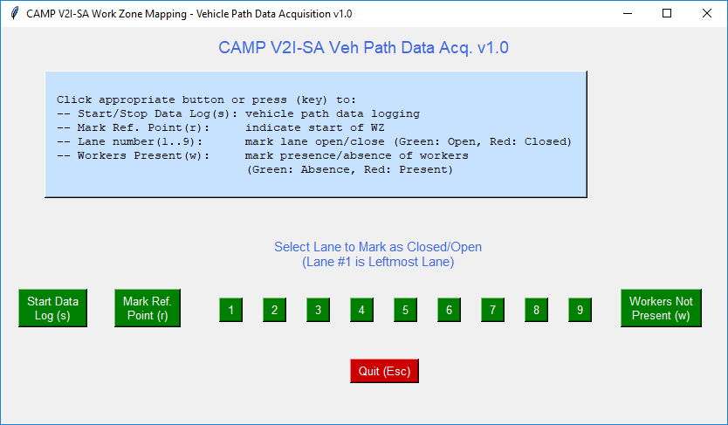
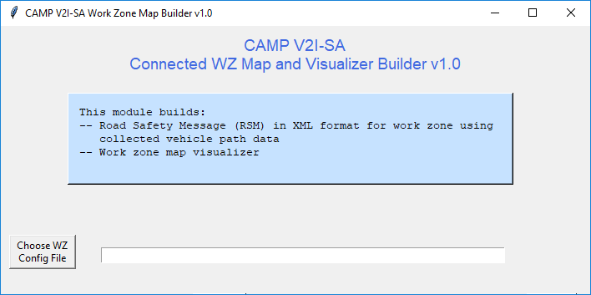
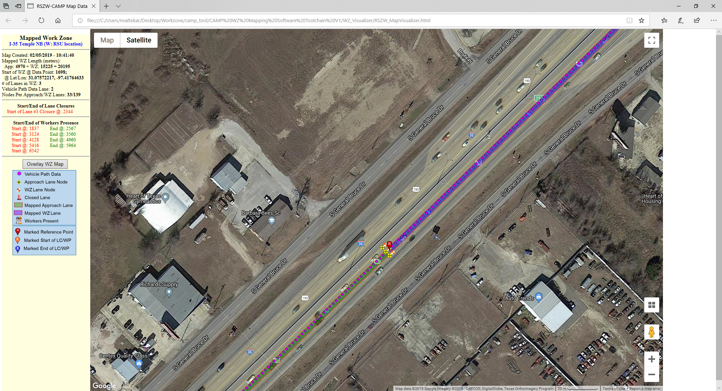
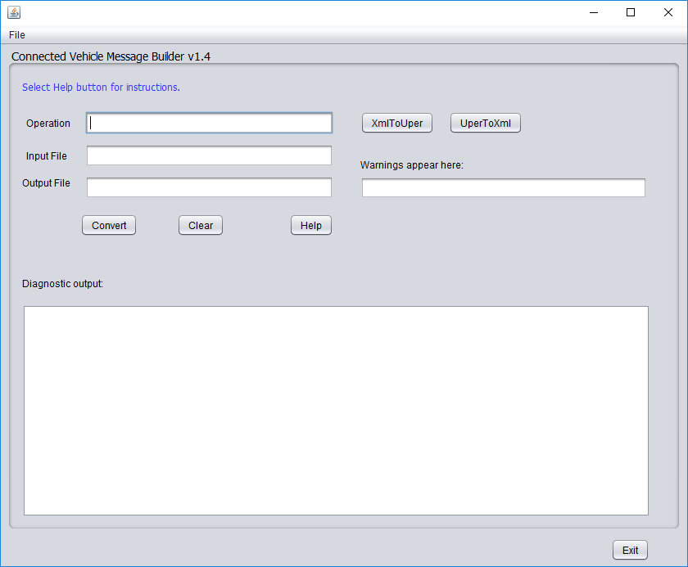
CAMP Software Toolchain - Flow

Slide 8
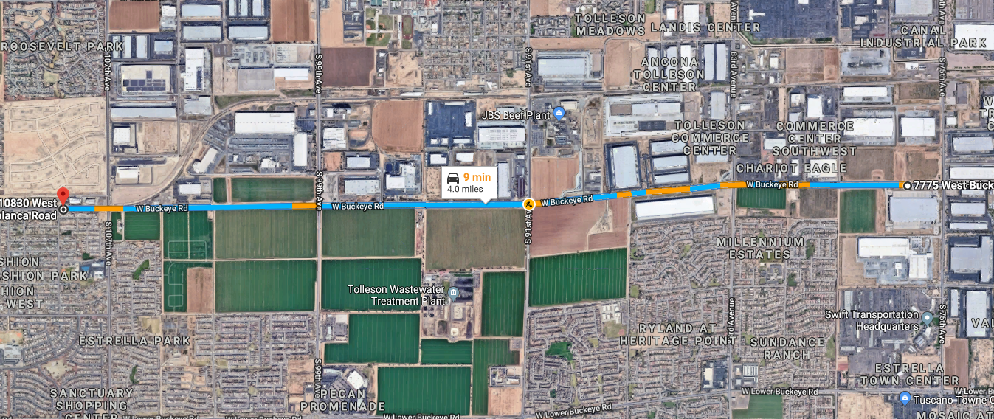
Data Collection on 03/28/2019 33.435425, -112.293444 to 33.437068, -112.225599
MC85/S-107th Avenue to MC85/S-75th Avenue (4.0 Miles)
One Round Trip (12:00PM – 01:00PM)
Data Captured: (.csv)
GPS waypoints, lane closures, presence of workers, locations of RSUs

Slide 9
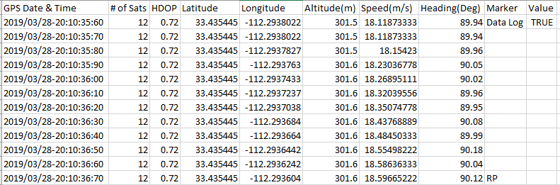
Data Collection on 03/28/2019 33.435425, -112.293444 to 33.437068, -112.225599
Data collected in (.csv) format
# of Data Points: 4641

Slide 10
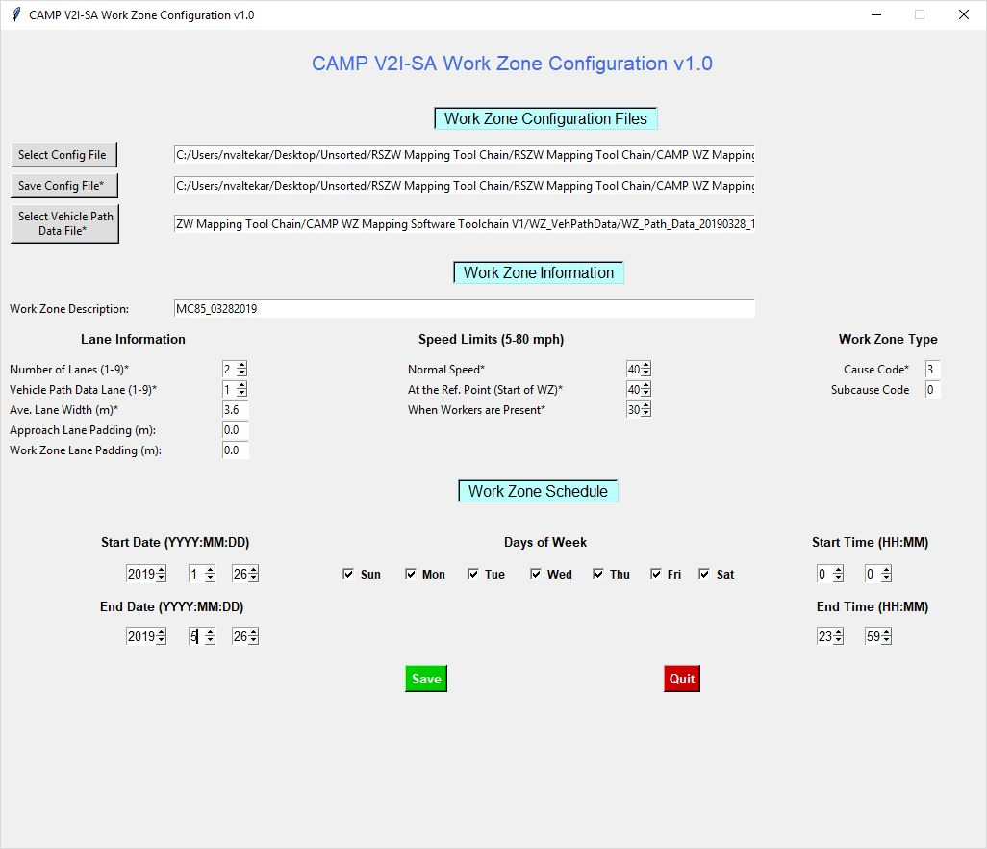
Work Zone Configuration

Slide 11
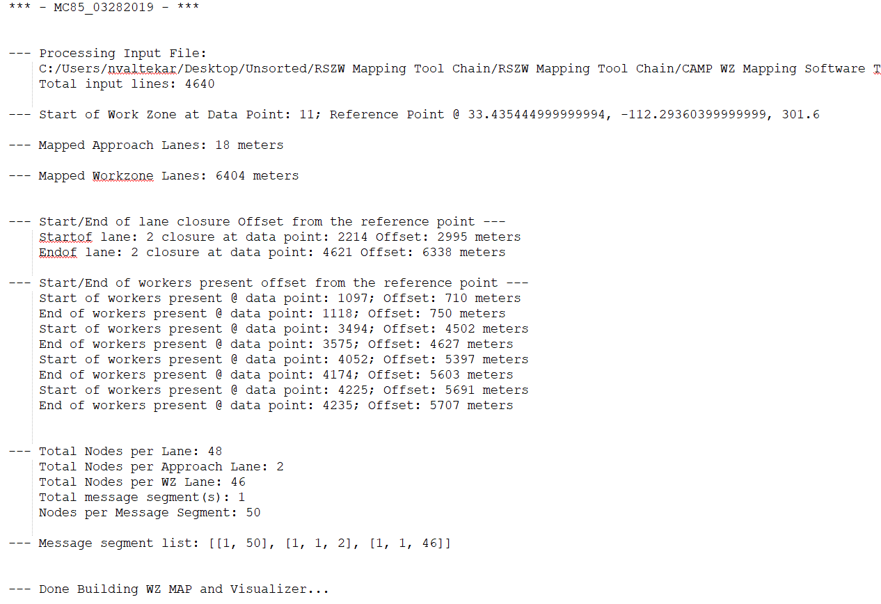
Map Builder - Info

Slide 12
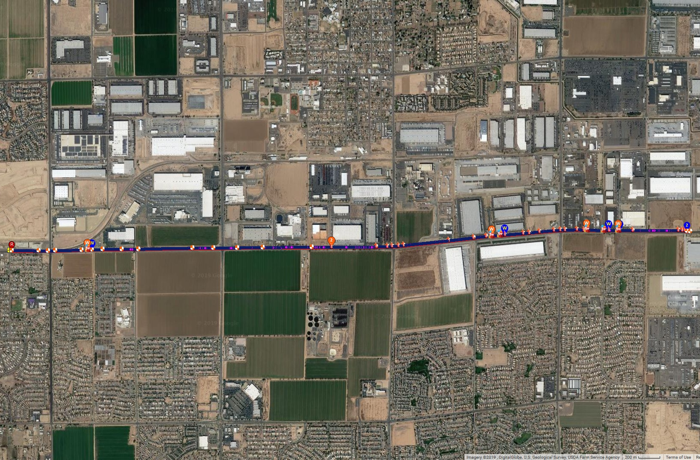
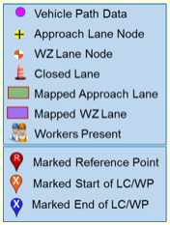
Map Visualizer

Slide 13
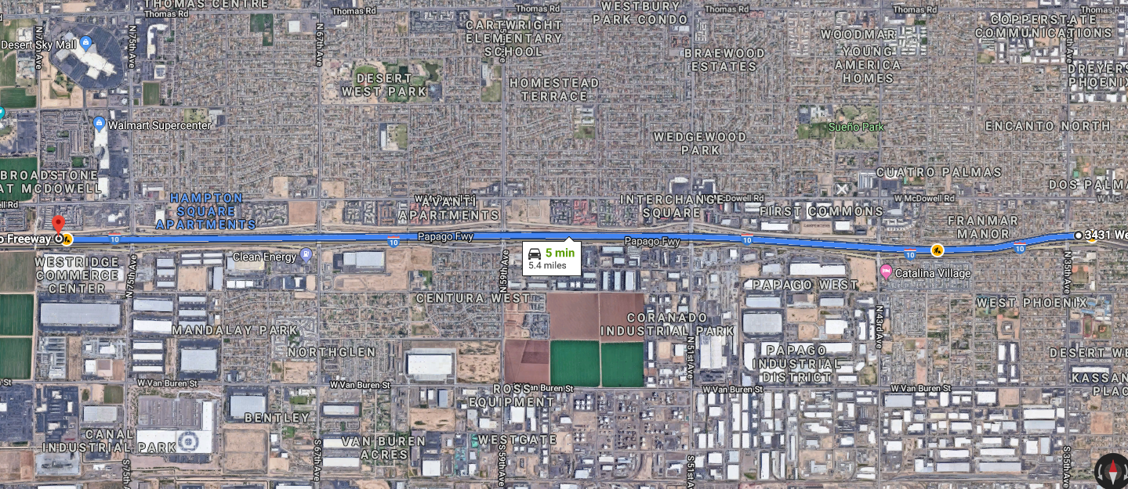
Data Collection on 04/19/2019 33.4631175, -112.1335158 to 33.46284333, -112.2274112
I-10/35th Avenue to I-10/75th Avenue (5.0 Miles)
One Round Trip (2:30PM – 3:30PM)
Data Captured: (.csv)
GPS waypoints, lane closures, presence of workers, lane merges

Slide 14
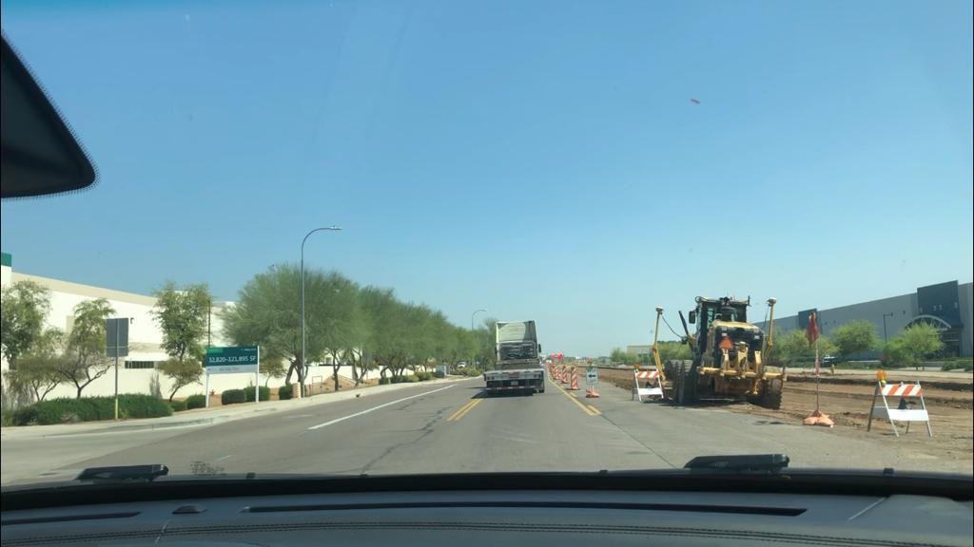
Questions (1)
Is data collection required for each change in the work-zone?
Changes in the message required as the configuration of the work-zone changes
For example, When lane closure/opening points change
Presence of workers is highly time dependent
Would data collection be required for each change?
If yes, any suggested guidelines to standardize the data collection process?

Slide 15
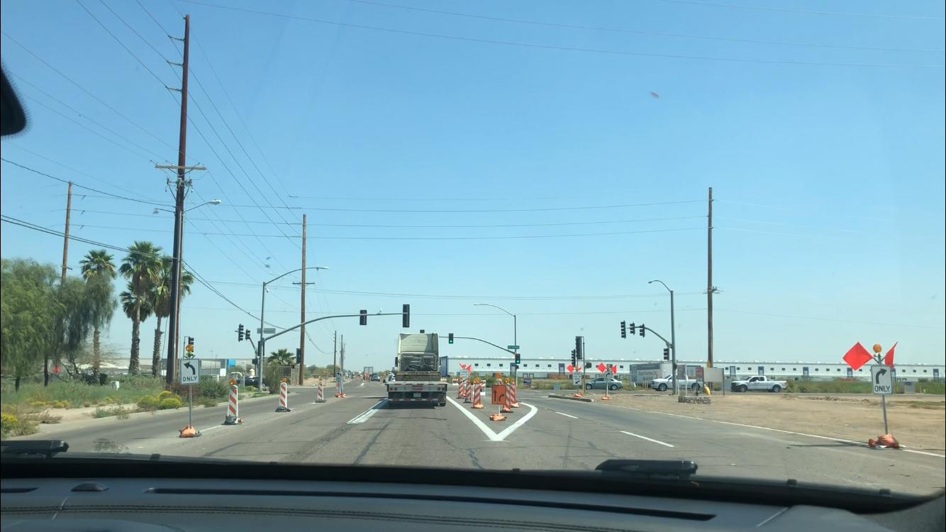
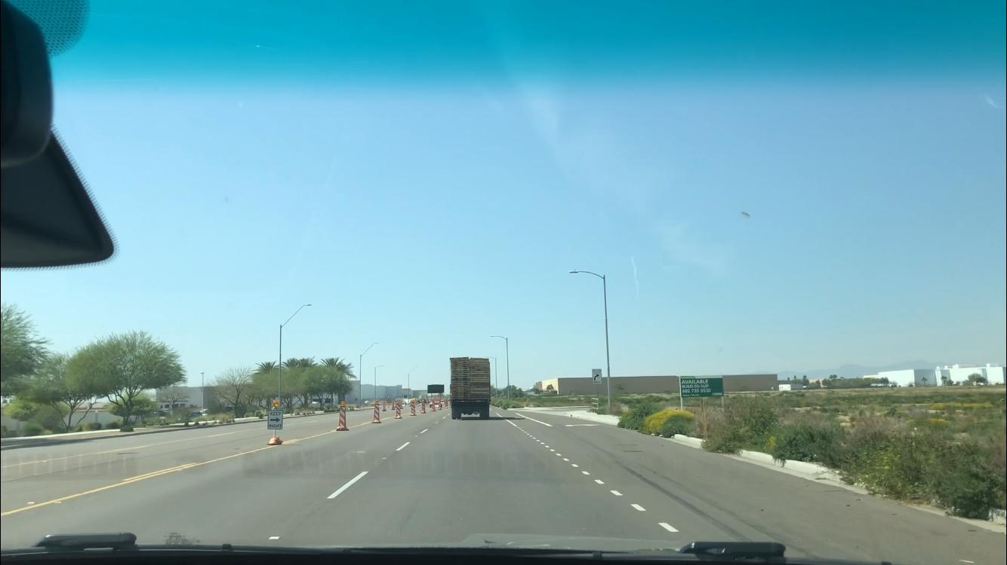
Questions (2)
Use Case: Dedicated left (or right) turn lanes in the vicinity of the intersections?
Use Case: Additional (dynamic) number of short lanes, not necessarily in the vicinity of the intersection.

Slide 16
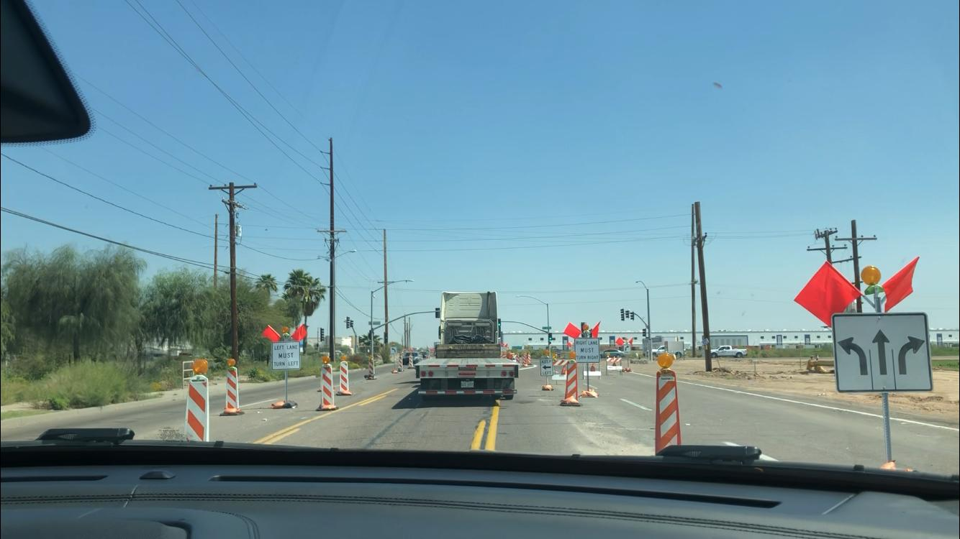
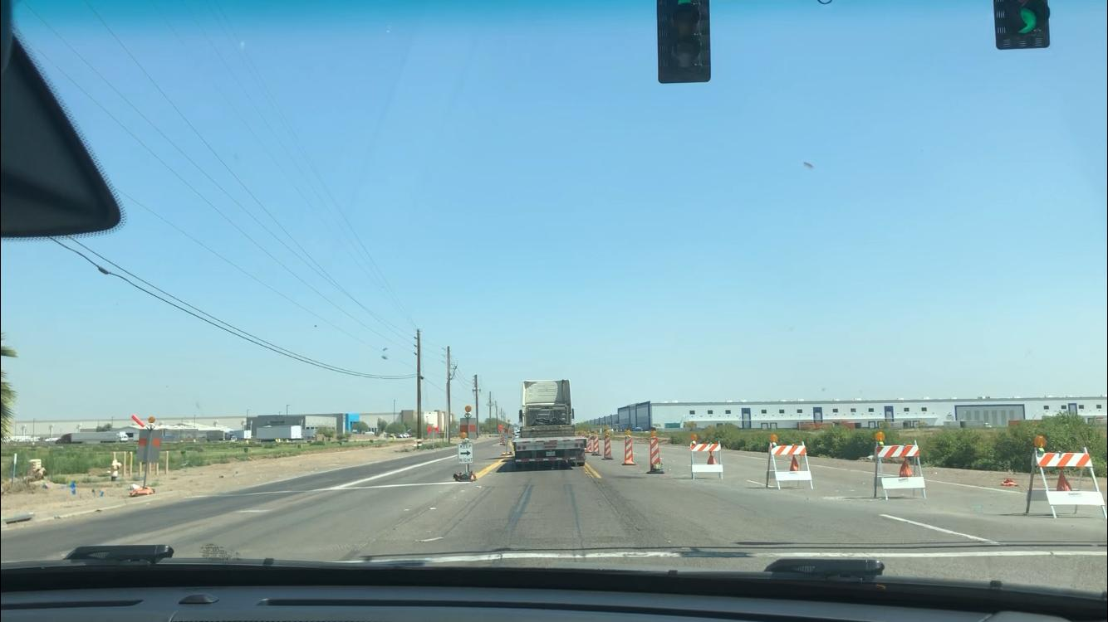
Questions (3)
Use Case: Usage of bidirectional-shared lane?
Use Case: Closure of all lanes and opening a new lane altogether (merging into bi-directional lanes) – Ambiguity during data collection.

Slide 17
Questions (4) - Freeway
Use Case: On freeways (refer I-10 data collection), the lanes that merge into exit ramp or merge from entry ramp.
Use Case: Dynamic changes in lane width.
Use Case: Considering HOV lane.
Use Case: Shoulder closures
Use Case: Variable speed limits within the work-zones.
General Use Case: ​UPER->XML decoding and XML->uper encoding of CV messages other than RSM, using the CV-message builder.

Slide 18
Other Observations and Notes
Savari SW1000 supports only TIM message for the store-repeat application.
However, we can forward the RSM message to the RSU for broadcast through RSU4.1 Interface
DSRC MsgID: 33
RSM message is highly flexible to include address many other roadside conditions such as:
School Zone Warnings
Rail Road Warnings
Weather/Road Conditions
Vehicle Breakdowns
Emergency Vehicle Alert
Reference: Connected Vehicle Message Builder User Guide v1.4
A general OBU application can be developed to address the probable conditions.

